Slide 1
Plataforma de Streaming Digital de Música BeatBase
Bases de Dados
Search
Home
Library
Diogo Fernandes 114137
Raquel Vinagre 113736
P4G6

Slide 2
Índice
01
02
03
04
Introdução
Desenvolvimento
Conceito do projeto
Requisitos e diagramas
3:15min
3:15min
Demo
Objetivos futuros
Vídeo do projeto final
Features a implementar
3:15min
3:15min

Slide 3
01
Top songs
Our Music Playlists
Search
Home
Library
You can enter a subtitle here if you need it

Slide 4
2021 wrap up
Do you know what helps you make your point clear?
Lists like this one:
They’re simple
You can organize your ideas clearly
You’ll never forget to buy milk!
And the most important thing: the audience won’t miss the point of your presentation

Slide 5
Your top listened artists of 2021
Mercury
Venus
You listened 4h35min
You listened 3h15min
Mercury is the closest planet to the Sun and the smallest one in the Solar System—it’s only a bit larger than the Moon
Venus has a beautiful name and is the second planet from the Sun. It’s hot and has a poisonous atmosphere

Slide 6
Top 3 songs of the weekend
Mercury
3:15
It’s the closest planet to the Sun and the smallest in the Solar System
Venus
3:20
Venus has a beautiful name and is the second planet from the Sun
Mars
3:10
Despite being red, Mars is actually a cold place. It’s full of iron oxide dust

Slide 7
Top podcasts of the year
Venus
1h4min
Jupiter
45min
Venus is the second planet from the Sun
It’s the biggest planet in the Solar System
Mars
30min
Saturn
1h15min
Despite being red, Mars is a cold place
Saturn is a gas giant and has several rings

Slide 8

A picture is worth a thousand words

Slide 9
Trending songs around the world
Mercury
Venus
3:15
2:01
Mercury is the closest planet to the Sun
Venus is the second planet from the Sun
Mars
Jupiter
2:18
3:30
Mars is actually a very cold place
Jupiter is the biggest planet of them all
Saturn
Neptune
1:50
3:19
It’s composed of hydrogen and helium
Neptune is the farthest planet from the Sun

Slide 10
Your top 10 songs
#1
#6
#2
#7
#3
#8
#4
#9
#5
#10
Mercury
Venus
It’s a Small Planet
Venus Is a Hot Planet
Mars
Jupiter
Mars Is Actually Cold
Jupiter Is a Gas Giant
Neptune
Earth
Neptune Is Far Away
Earth Is Our Planet
Saturn
Pluto
Saturn Has Rings
It’s Now a Dwarf Planet
Sun
Moon
The Sun Is a Star
The Moon Is a Satellite

Slide 11
Our Music Playlists
Search
“This is a quote, words full of wisdom that someone important said and can make the reader get inspired.”
Home
Library
—Someone Famous

Slide 12
Minutes heard for top artists
150,000
185,000
200,000
Mercury
Full playlist
It’s the closest planet to the Sun and the smallest in the Solar System
Follow
Venus
Full playlist
Venus has a beautiful name and is the second planet from the Sun
Follow
Mars
Full playlist
Despite being red, Mars is actually a cold place. It’s full of iron oxide dust
Follow

Slide 13
150,000
Our Music Playlists
Search
Home
Library
Big numbers catch your audience’s attention

Slide 14
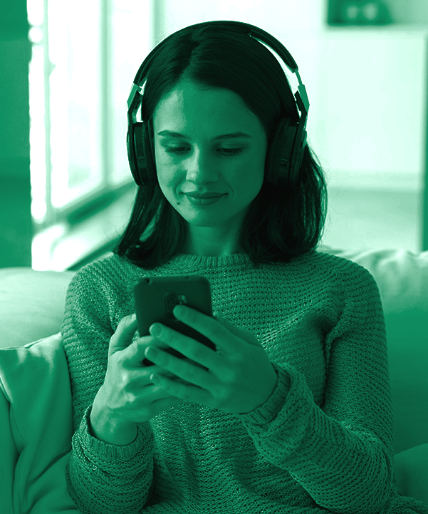
Artist description
Our Music Playlists
Search
Home
Follow
Library
Images reveal large amounts of data, so remember: use an image instead of a long text. Your audience will appreciate it

Slide 15
Awesome words
Our Music Playlists
Search
Home
Library

Slide 16
Top playlists in the world
Mercury
Follow
It’s the closest planet to the Sun
Venus
Follow
Venus has a beautiful name
Mars
Follow
Despite being red, Mars is cold

Slide 17

Your most listened genres in 2021
Rock
30%
Classic
20%
30%
20%
Jupiter is the biggest planet
Mercury is the smallest planet
Total: 35,000 minutes
Pop
10%
Latin
40%
Despite being red, Mars is cold
Venus has a beautiful name
10%
40%
Follow the link in the graph to modify its data and then paste the new one here. For more info, click here

Slide 18
2022 summer playlist - Part 1
Order by
# | Title |  | Album | Date | Duration
1 |  | Name of the song A | Album A | Jul 3, 2020 | 5:00
2 |  | Name of the song B | Album B | Aug 4, 2019 | 3:45
3 |  | Name of the song C | Album C | Sep 7, 2019 | 2:50
4 |  | Name of the song D | Album D | Jul 2, 2019 | 4:00
5 |  | Name of the song E | Album E | Oct 1, 2020 | 3:50
6 |  | Name of the song F | Album F | Jan 2, 2019 | 4:00
7 |  | Name of the song G | Album G | Feb 9, 2020 | 3:01

Slide 19
2022 summer playlist - Part 2
# | Title |  | Album | Date | Duration
8 |  | Name of the song H | Album H | Jul 4, 2020 | 3:00
9 |  | Name of the song I | Album I | Aug 8, 2019 | 2:45
10 |  | Name of the song J | Album J | Sep 9, 2019 | 5:50
11 |  | Name of the song K | Album K | Jul 1, 2019 | 3:00
12 |  | Name of the song L | Album L | Oct 7, 2020 | 2:50
13 |  | Name of the song M | Album M | Jan 1, 2019 | 3:00
14 |  | Name of the song N | Album N | Feb 8, 2020 | 3:01

Slide 20
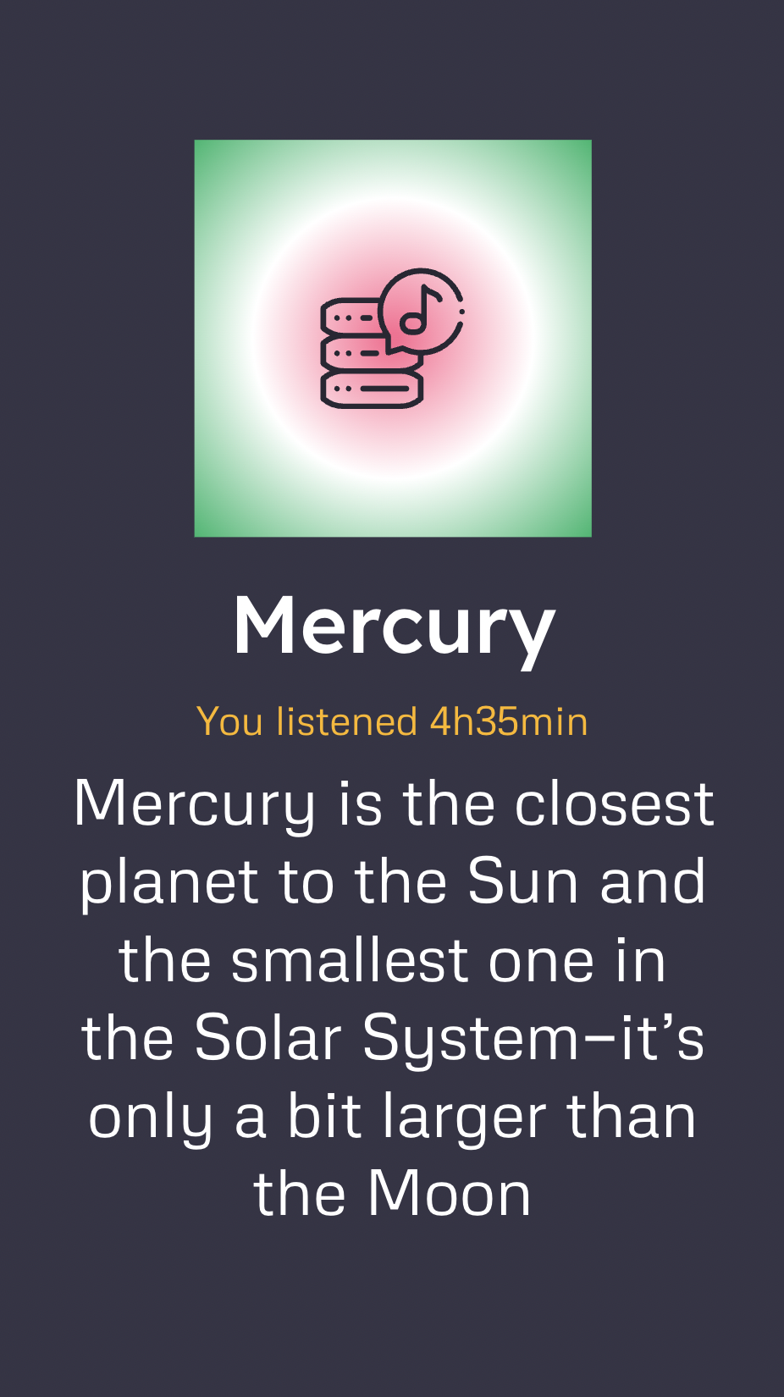
Share some of your music playlists
You can replace the image on the screen with your own work. Just right-click on it and select “Replace image”

Slide 21
Your 2021 music app wrap up
25%
Top 3 artists
Your favorite song was…
Jane Doe
You listened to 7h35min
Favorite song: Venus
75%
Sam Smith
Mercury
Music
You listened to 4h35min
Favorite song: Mars
by Jane Doe
Venus is hot
Nick Jones
You listened to it
Podcast
155
Mars is cold
You listened to 2h15min
Favorite song: Earth
times. You really liked it!

Slide 22
Your most active months
April
August
December
Venus is terribly hot
Saturn is a gas giant
Jupiter is the biggest
Total time: 12h45m
Total time: 10h5m
Total time: 15h45m
Genre: Reggaeton
Artist: Sam Smith
Song: Venus
Genre: Rock
Artist: Sam Smith
Song: Mars
Genre: Pop
Artist: Sam Smith
Song: Venus
January
June
November
Mercury is a small planet
Mars is actually cold
Neptune is far away
Total time: 10h34m
Total time: 11h3m
Total time: 10h59m
Genre: Pop
Artist: Jane Doe
Song: Mercury
Genre: Pop
Artist: Nick Jones
Song: Neptune
Genre: Latin
Artist: Sam Smith
Song: Mercury

Slide 23
Thanks!
Our Music Playlists
Search
Home
Library
Do you have any questions?
youremail@freepik.com
+34 654 321 321
yourwebsite.com
Please keep this slide for attribution

Slide 24
Music streaming icon pack

Slide 25
Alternative resources
Here’s an assortment of alternative resources whose style fits the one of this template:
Vectors:
Selection of black sound waves with different designs

Slide 26
Resources
Did you like the resources on this template? Get them for free at our other websites:
Vectors:
Music player app for mobile phones
Icons:
Music Streaming Icon Pack
Photos:
Medium shot man listening music
Young woman listening to music at home

Slide 27
Fonts & colors used
This presentation has been made using the following fonts:
Lexend Deca
(https://fonts.google.com/specimen/Lexend+Deca)
Metrophobic
(https://fonts.google.com/specimen/Metrophobic)
#ffffff
#353445
#ff6a92
#00b76c
#ffb600
#282733
#dcdee2

